Slide 1
Sports Coaching in the US
June 2024
US Industry Report

Slide 2
IBISWorld | Sports Coaching in the US
Jun 2024
Definition
"Winning goal: Rising incomes and employment will boost spending from the industry's top clients"
This industry includes one-on-one sports training at athletic facilities, camps and schools that offer instruction in athletic activities to groups or individuals. Overnight and day sports instruction camps are also included in this industry.
Industry Report

Slide 3
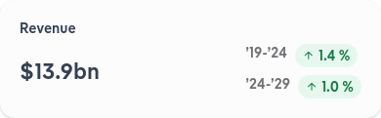
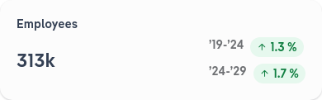
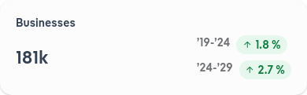

IBISWorld | Sports Coaching in the US
Jun 2024
Performance Highlights
Revenue is set to return to stable growth. As inflation wanes and employment recovers, parents will be more willing and able to send their kids to high-quality sports camps.
Industry Report
Notes:
Parents invest serious money into private athletic instruction, expensive travel teams, intensive sports camps and college showcase events. Many hope to earn their children college scholarships in the wake of rising tuition costs.
Athletes have moved away from team sports, reducing demand for sports coaches' most lucrative services. A shift from frequent to more casual sports participation has forced sports coaches to try and earn more money from fewer athletes.

Slide 4
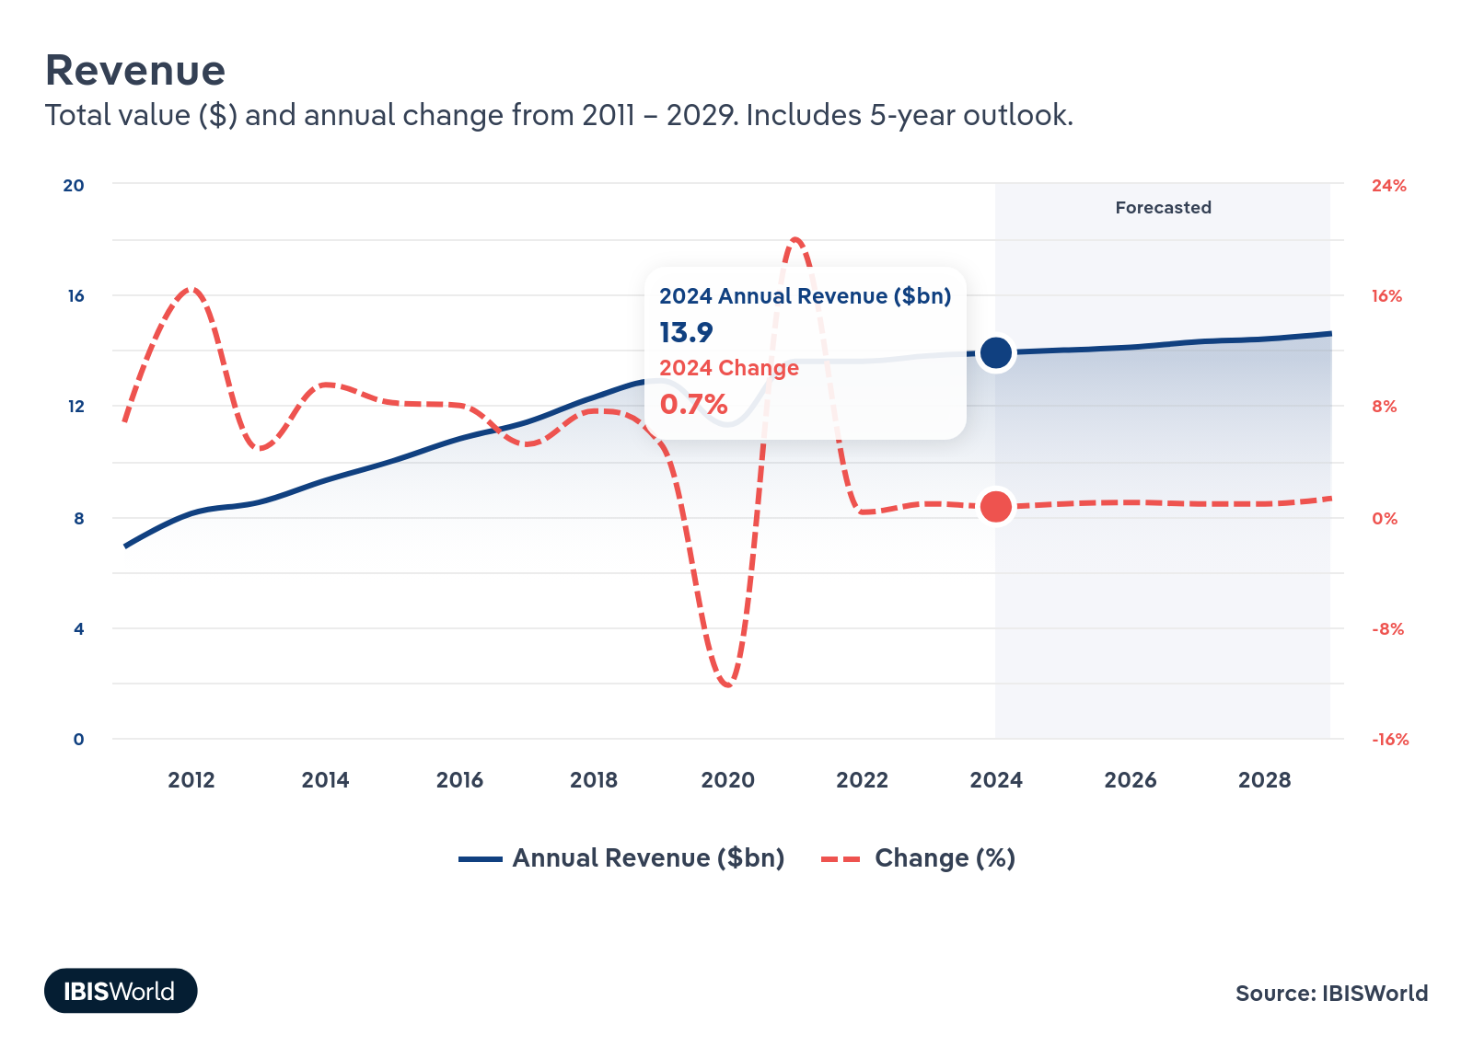
IBISWorld | Sports Coaching in the US
Jun 2024
Industry Revenue
Sports coaches successfully rebounded from the pandemic. COVID-19 forced many sports coaches to halt instruction until quarantines were lifted. Coaches weren't able to operate at full capacity for their crucial summer season, and revenue took a downturn for the first year since 2009.
Industry Report

Slide 5
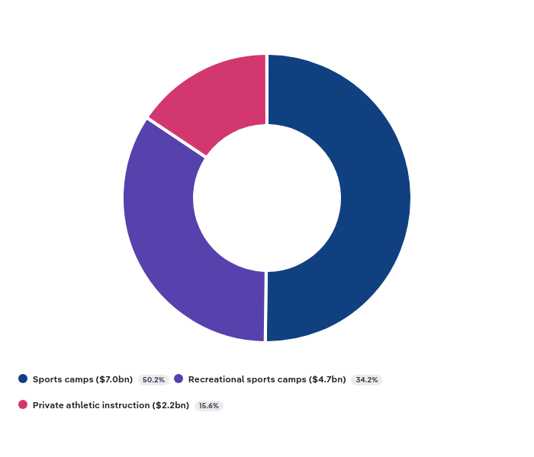
IBISWorld | Sports Coaching in the US
Jun 2024
Products and Services
Sports camps earn coaches significant revenue. Camps can be split into recreational day camps for a broad base of younger, casual and more intensive, sometimes overnight camps for older athletes. Sports camps earn more revenue than day camps.
Industry Report
Notes:
Teenage athletes tend to focus on preparing for college athletics. Parents invest heavily in college showcases and intensive training to earn potential scholarships.

Slide 6
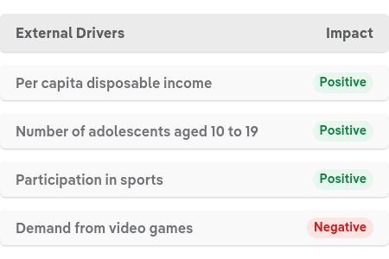
IBISWorld | Sports Coaching in the US
Jun 2024
Key External Drivers
Most sports coaches attain a license through a sport-specific organization. Earning a license may require a class and examination for a fee.
Industry Report

Slide 7
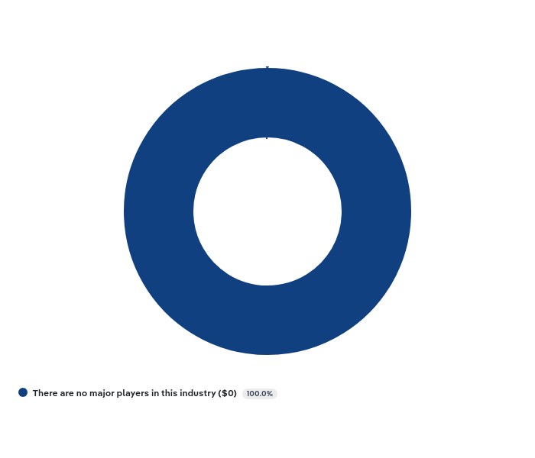
IBISWorld | Sports Coaching in the US
Jun 2024
Companies
Industry Report

Slide 8
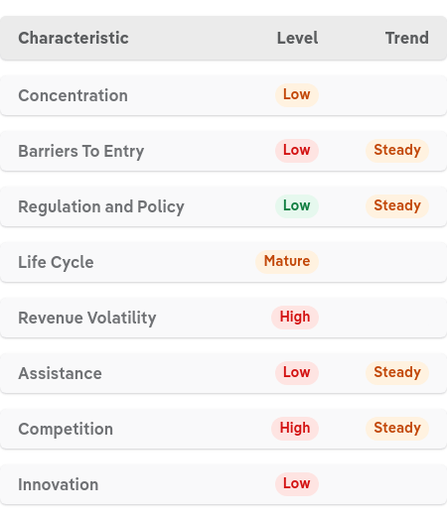
IBISWorld | Sports Coaching in the US
Jun 2024
Industry Structure
Industry Report

Slide 9
Thank You Got Questions? Call 1-800-330-3772 or email info@IBISWorld.com
US Industry Report

